Slide 1
Sequences
Abylkassymova A.B.

Slide 2
String

Slide 3
Overview
Strings are a data type in Python for dealing with text.
A string is a sequence of characters.
It is stored and manipulated as a combination of 0’s and 1’s. Encoding – Decoding.
In Python – Unicode characters.
Python has a number of powerful features for manipulating strings.

Slide 4
Representation
To represent a string, you wrap it within quotes. There can be multiple ways of doing this:
Single quotes, just like in this example:
'Single quote allow you to embed "double" quotes in your string.'
Double quotes. For example:
"Double quote allow you to embed 'single' quotes in your string."
Triple quotes, as in this example:
"""Triple quotes using double quotes""", '''Triple quotes using single quotes.'''
Triple quoted string let you work with multiple line strings, and all associated whitespace will be included in the string.

Slide 5

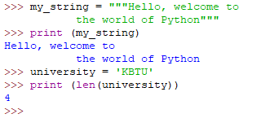
Creating a string
Usual string
Input string
Empty string
The length of string

Slide 6
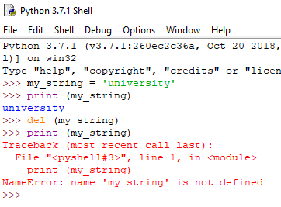
How to change or delete a string?
Strings are immutable => The elements of a string cannot be changed once it has been assigned.
We can simply reassign different strings to the same name.
We cannot delete
or remove characters
from a string. But
deleting the string
entirely is possible
using the keyword
del.

Slide 7
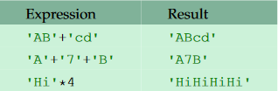
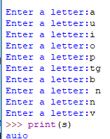

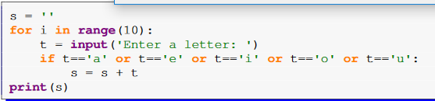
Concatenation and repetition
Examples:
Output?

Slide 8
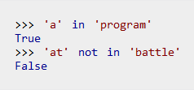
The in operator
The in operator is used to tell if a string contains something. For example:

Slide 9
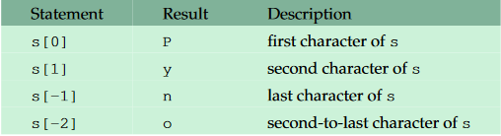
Indexing
To pick out individual characters from a string.
If: s=‘Python’
BE AWARE: s[10] – does not exist!

Slide 10
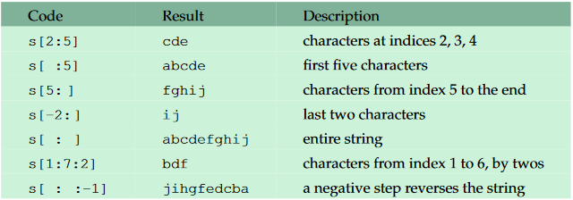

Slices
To pick out part of a string.
Suppose: s='abcdefghij‘
index: 0 1 2 3 4 5 6 7 8 9
letters: a b c d e f g h i j
Result?

Slide 11

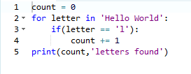
Looping
To scan through a string one character at a time.
To keep track of our location in the string during the loop.
Example:
Result?

Slide 12
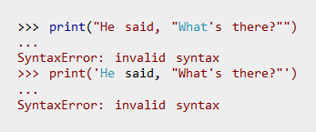
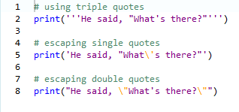

Escape characters
He said, “What’s there?” – how to print?
.
To use triple quotes:
To use escape sequences:

Slide 13
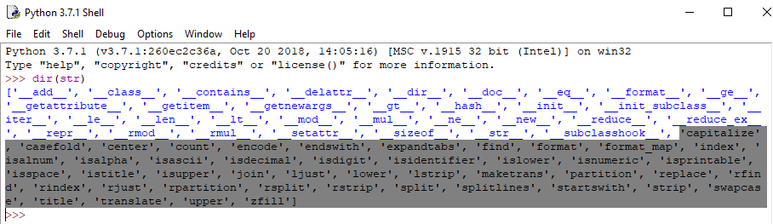
All other methods of String
To see a list of all the string methods, type into the Python shell:
dir(str)

Slide 14
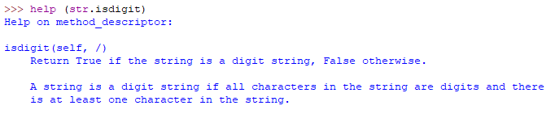
More detailed info
To read Python’s documentation for one of the methods, say the isdigit method, type:
help(str.isdigit)
….

Slide 15
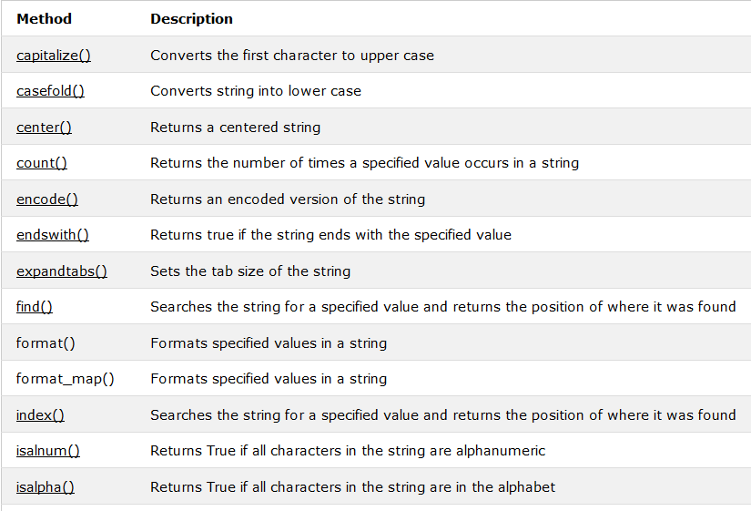
Table of String Built-in Methods
Many more ……

Slide 16
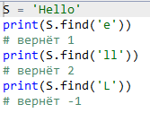

String methods examples (find/rfind)
The find()/rfind() method returns the index of first/last occurrence of the substring (if found). If not found, it returns -1.
returns the highest index of the substring

Slide 17
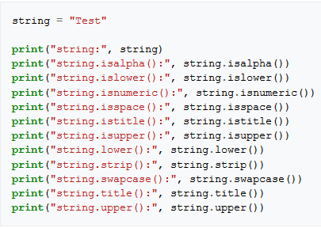
Other String methods Examples

Slide 18
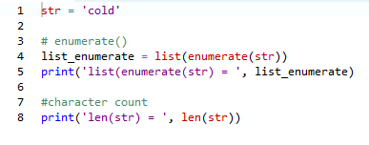

More Examples

Slide 19
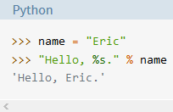
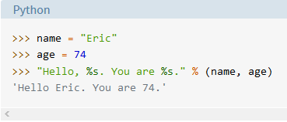
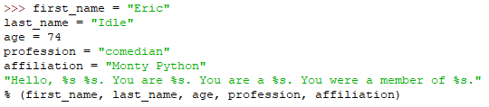
String Formatting
%-formatting
It is ok for simple variables:
It isn’t great for several parameters/longer strings/tuples/dictionaries:

Slide 20
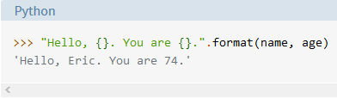
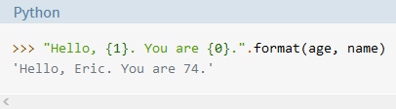
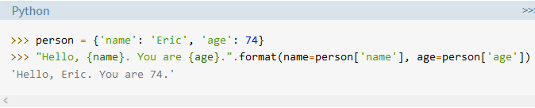
String Formatting
2. str.format()
It is ok for almost everything:

Slide 21
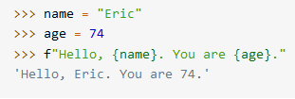
String Formatting (f-String)
3. f-Strings (since Python 3.6):
Simple Syntax (less verbose):
At the beginning and curly braces containing expressions
that will be replaced with their values. F – will also work!

Slide 22

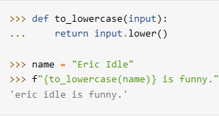

String Formatting (f-String)
Arbitrary Expressions:

Slide 23
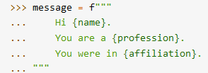
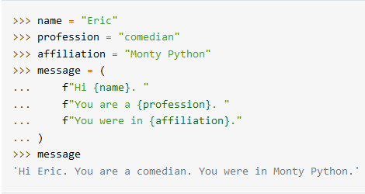
String Formatting (f-String)
Multiline f-strings:
f in front of each line of a multiline string.
Otherwise -> syntax error

Slide 24
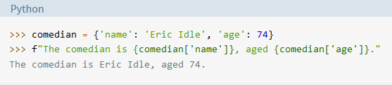
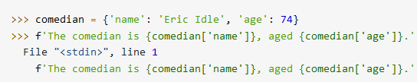
String Formatting (f-String)
Dictionaries:
Will be good!
Will cause an error…..why?

Slide 25
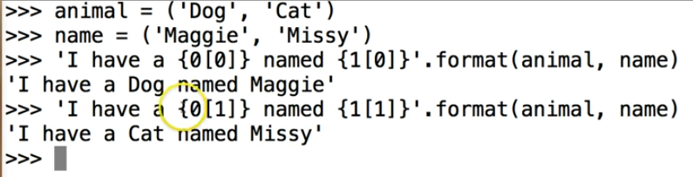
More about formatting …
Hints for dictionaries:

Slide 26
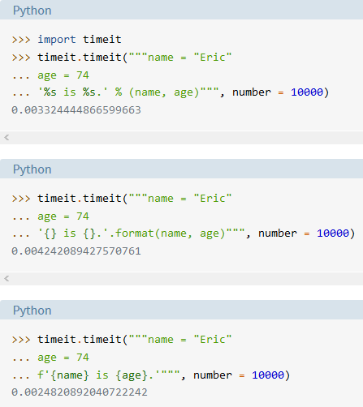
String Formatting (f-String)
Speed!

Slide 27
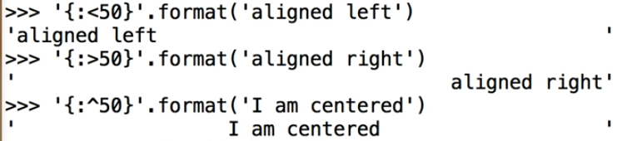

More about formatting …
Aligning using formatting:

Slide 28
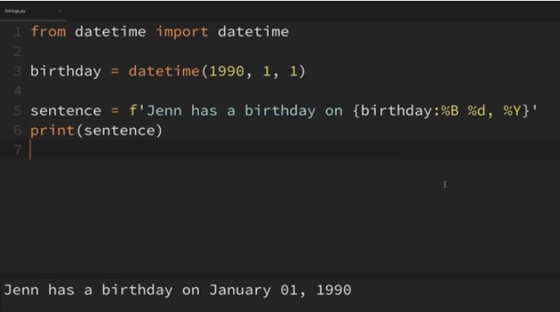
String formatting for dates

Slide 29
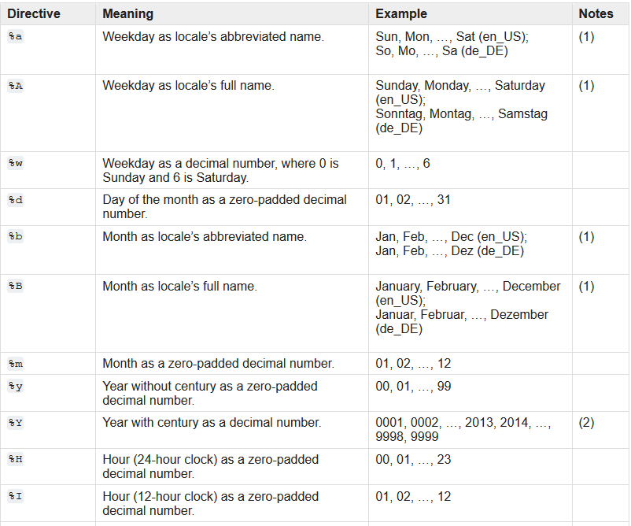

Slide 30
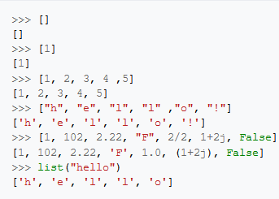
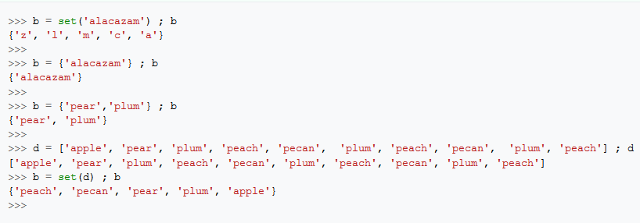
What we already know?
Lists – a set of iterable item(s).
Example:
Sets are mutable like lists;
The set can only contain unique
items;

Slide 31
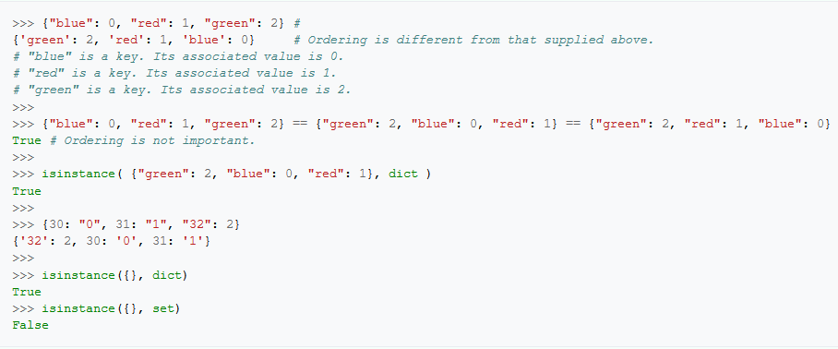
What we already know?
Dictionaries - a random sequences that contain a set of keys, where each key points to a value and is associated with that value;

Slide 32
Lists

Slide 33
Overview
Sometimes hard to work with;
Lists are incredibly important in Python;
Python offers the flexibility of using mixed data sorts in the same list;
However restricting a list to a single type when you can is always the best practice!

Slide 34

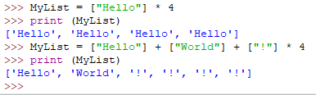
Creating a list
Mixed types
Square brackets
Printing
Notice that the string entries appear in single quotes, even though you typed them using double quotes. Strings can appear in either single quotes or double quotes in Python.
TRY THIS ☺

Slide 35
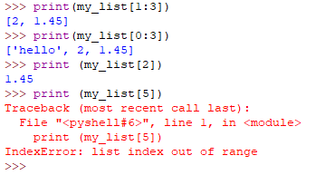
Accessing a List
Slicing
Accessing one value
Common error
You can use negative indexes with Python. Instead of working from the left, Python will work from the right and backward.

Slide 36
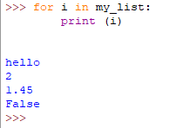

Looping through Lists/Length of the list
Remember!
The length of list

Slide 37
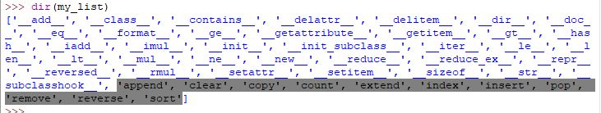
What is available?
Python displays a list of actions that you can perform using lists:

Slide 38
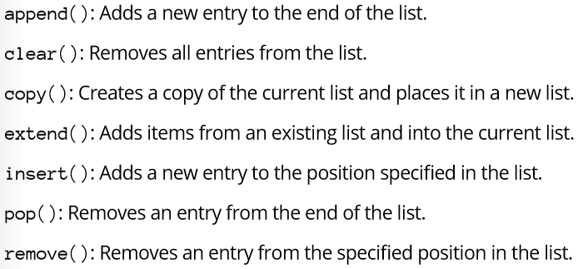
Modifying Lists
Modifying a list means the acronym CRUD:
C (create) - add a new entry
R (remove) – delete an existing entry
U (update) – change an existing entity
D (delete) – remove an existing entry.

Slide 39



Append() – add a new element to the end of the list
Insert() – inserts an new element to the specified place

Slide 40
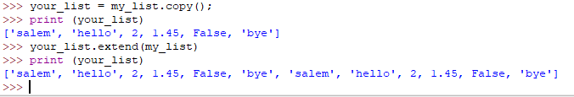
Copy(), Extend()
Creates copy of a list
concatenates two lists

Slide 41
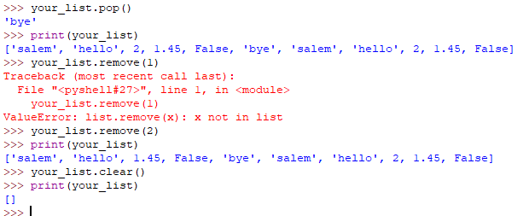
Pop(), remove(), clear()
removes elements from the end of a list
removes elements from the of a list, NOT INDEX
clears a list

Slide 42
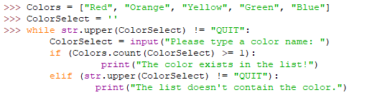
Searching Lists
What does this code do?

Slide 43
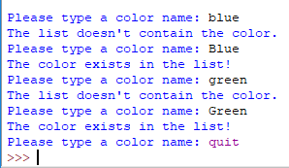
Output
What is good/bad here?

Slide 44
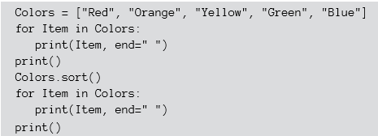
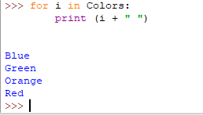
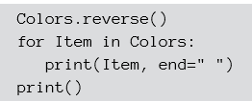
Sorting Lists
Example:
sorted list
Output?

Slide 45
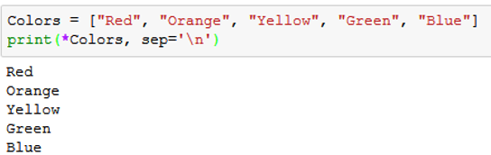

Printing Lists
Python provides myriad ways to output information!
.
.
method, which right justifies the string

Slide 46


Printing Lists …
.
.
method to join the newline character with each member of Colors
the output is formatted in a specific way with accompanying text,
and the result doesn’t include every member of Colors.

Slide 47

Counter Object
Suppose you have a very long list and you need to calculate how many times meets one or other element in the list….
import it from collections
A new Counter Object
3 types of printing
Notice that the information is actually stored in the Counter as a key and value pair

Slide 48
When to Use Lists
When you need a mixed collection of data all in one place.
When the data needs to be ordered.
When your data requires the ability to be changed or extended. Remember, lists are mutable.
When you don't require data to be indexed by a custom value. Lists are numerically indexed and to retrieve an element, you must know its numeric position in the list.
When you need a stack or a queue. Lists can be easily manipulated by appending/removing elements from the beginning/end of the list.
When your data doesn't have to be unique. For that, you would use sets.

